Slide 1
50.003 Elements of Software Construction
with a focus on concurrency

Slide 2
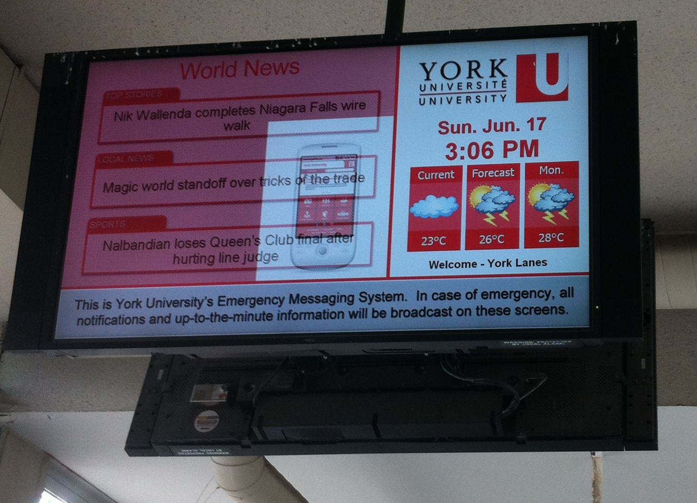
Instructor: Sun Jun
Sun Jun
Father of Two
Computer Scientist
Likes Algorithms
Vulcan Type
Black/White guy
Overly rational
Likes to argue
Office: 1.302-11
sunjun@sutd.edu.sg

Slide 3
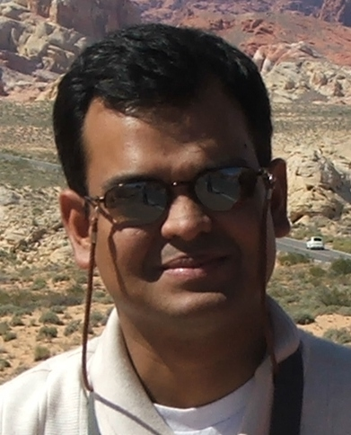
Instructor: Subhajit Datta
Father of a two year old
Likes to write, in programming languages as well as natural languages
Find out more at www.dattas.net
Email:
subhajit_datta@sutd.edu.sg

Slide 4
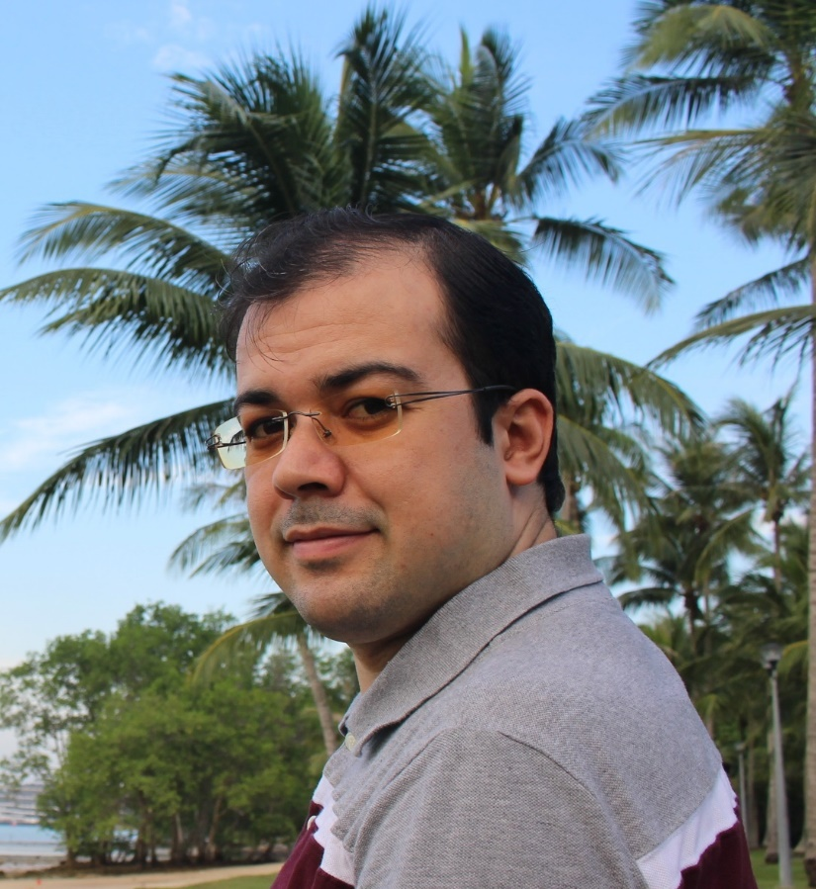
Teaching Assistant: Hamid
Hamid Reza Ghaeini
PhD student at ISTD
Office: Block 1, Level 7, 1.710-S17.
Email: Ghaeini@acm.org
Homepage:
http://member.acm.org/~ghaeini

Slide 5
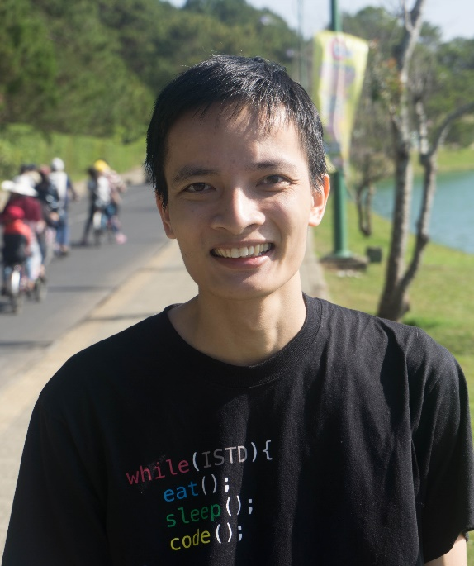
Teaching Assistant: Tung
I am Hoang Thanh Tung, PhD student
My research interest is in the intersection of Machine Learning and Software Engineering
My current research project is about mining patterns in huge code bases

Slide 6
Course Plan
Week | Tue. 9:30 to 11:00 | Wed. 9:00 to 10:30 | Thu. 1:00 to 3:00 | Remarks
1 (Jan 25) | Software Development Process
2 (Feb 1) | Guest Lecture | Software Design and UML |  | Problem Set 1
3 (Feb 8) | Holiday | Design Patterns |  | Problem Set 2; Quiz 1
4 (Feb 15) | Project Meeting I | Introduction to Concurrency and Sockets |  | Problem Set 3
5 (Feb 22) | Basics of Threads |  |  | Problem Set 4; Quiz 2
6 (Feb 29) | Thread Safety and Synchronization |  | Project Meeting II | Problem Set 5
7 (Mar 7) | Recess
8 (Mar 14) | Composing Thread-safe Objects |  |  | Problem Set 6; Quiz 3
9 (Mar 21) | Building Blocks |  |  | Problem Set 7
10 (Mar 28) | Tasks and Thread Pools |  | Project Meeting III | Problem Set 8; Quiz 4
11 (Apr 4) | Concurrency Pitfalls and Testing |  |  | Problem Set 9
12 (Apr 11) | Performance |  |  | Problem Set 10; Quiz 5
13 (Apr 18) | Final Project Presentation (15 minutes for each group) |  |  | Project Report/Code Due
14 (Apr 25) | Final Exam

Slide 7
Components
Problem Sets – 20%
Quizzes – 10%
Course Project – 40%
Final Exam – 30%
The project weights more than the exam.

Slide 8
Course Project
You and your team will form a software company.
Your company is about to develop an Android App (recommended to be a multi-user realtime game).
Your will present (with a live demo) the App in the week of April 18.
You have only three months!

Slide 9
Miscellaneous
Teams
Check out the class website to see which team you belong to
Course Website:
people.sutd.edu.sg/~sunjun/teach/50-003-2016/
Office Hour: Wednesdays 2 - 4

Slide 10
Cohort Exercise 1 (15 Min)
Find your group and sit together.
Say hello to each other.
Come up with a name for your app company.
Discuss on what you would like to develop and how you plan to finish it before the deadline.

